Slide 1




AIRPORT OPERATIONS OPTIMIZATION
GROUP 13
Preetish Parikh | Harsh Jasrapuria | Aman | Megha Agrawal | Siddharth Bam

Slide 2
ABOUT THE DATABASE
Data sourced from the BTS Airline On-Time Statistics and Performance database, covering December 2023 to August 2024., accessible at https://www.transtats.bts.gov/ontime/Departures.aspx. The dataset provides comprehensive details on flight departures, delays, and cancellations for U.S. airports.
This project focuses on analyzing data from five major U.S. airports:
Atlanta (ATL)
Chicago (ORD)
Dallas-Fort Worth (DFW)
Los Angeles (LAX)
Denver (DEN)
Dataset includes over 1 million rows, with detailed analysis of August 2024 (130,000+ rows).The analysis encompasses data from major domestic airlines, including: Delta Airlines, United Airlines, American Airlines, Southwest Airlines, Frontier Airlines and Much More.
Key metrics analyzed in this project include:
Flight details (origin, destination, carriers).
Delay metrics (arrival, security, weather, NAS, late aircraft).
Flight performance (on-time percentages, cancellations, diversions).
Airline-specific and airport-specific insights.

Slide 3







INTRODUCTION
The aviation industry is a critical component of modern transportation, connecting millions of passengers and cargo across the globe.
By leveraging Tableau, this project translates raw data into meaningful visualizations, enabling stakeholders to better understand trends, address inefficiencies, and optimize airport and airline operations.

Slide 4
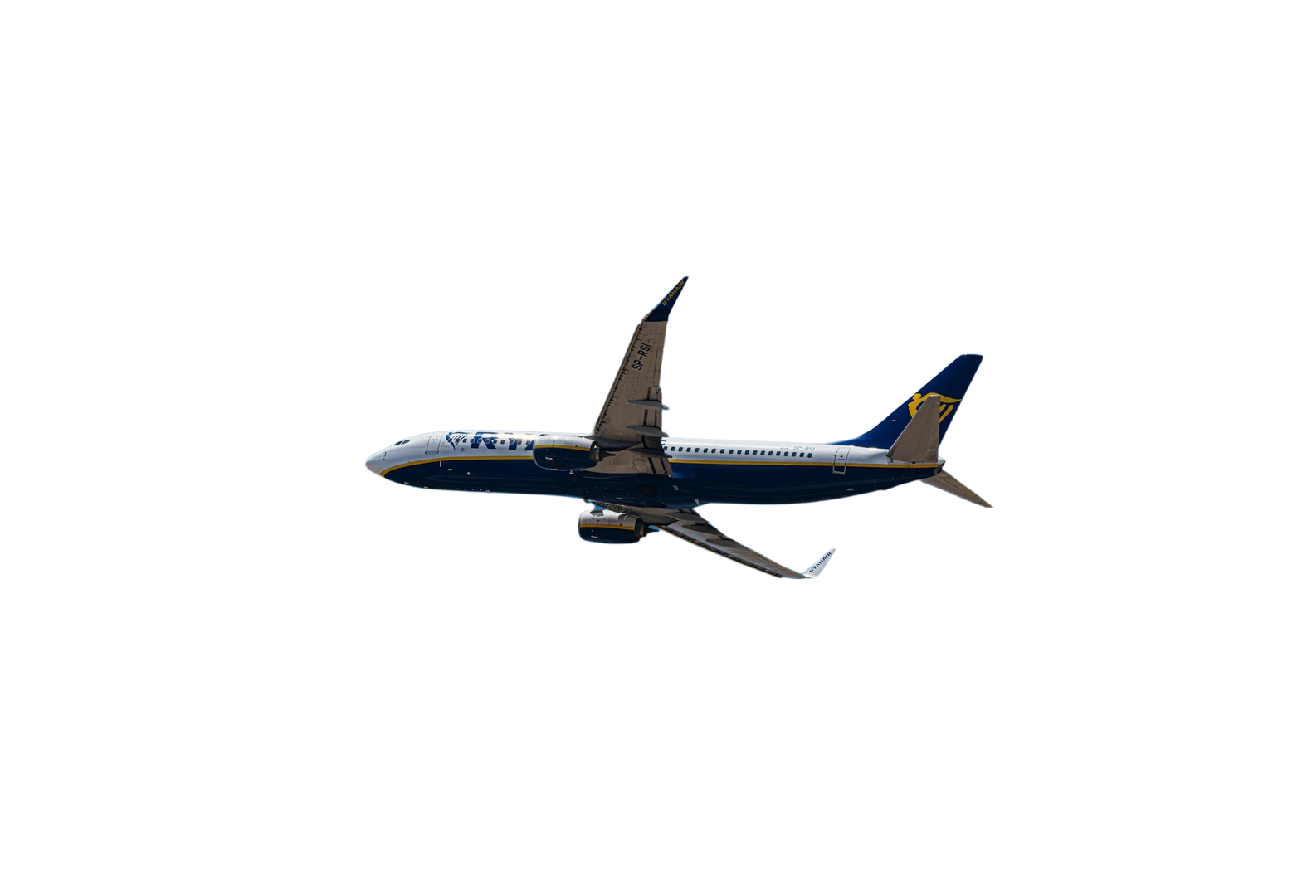
OBJECTIVE
VISION
Track and visualize key performance metrics for airlines and airports.
Identify patterns in delays, cancellations, and diversions by airport and carrier.
Create an interactive Tableau dashboard for decision-makers to explore data for operational enhancements.
Deliver actionable recommendations to improve airport efficiency and enhance passenger experience.
Empower airport authorities with data-driven insights to address challenges like delays, cancellations, and diversions.
Provide comprehensive analysis to identify root causes, optimize performance, and improve operational efficiency.
Deliver actionable intelligence to enable smarter decision-making and enhance the overall travel experience.

Slide 5
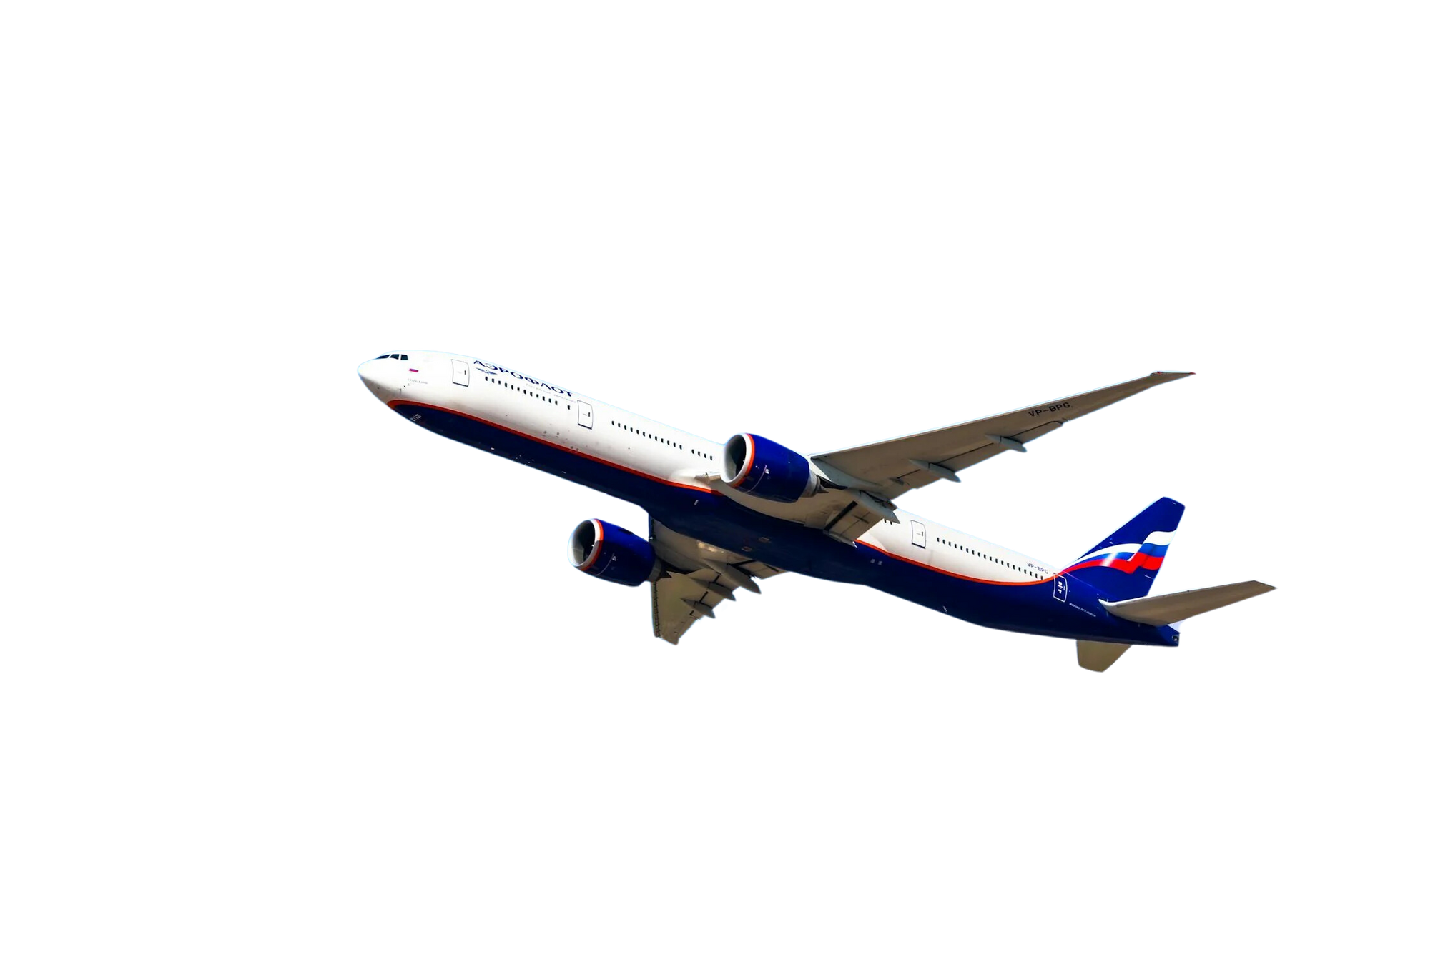
OUR PROJECT
Comprehensive analysis of flight operations, delays, cancellations, diversions, and performance trends for the five busiest airports in the USA.
Provides actionable insights into traffic patterns, punctuality, and carrier-specific metrics to identify key operational efficiencies.
Supports data-driven decision-making to enhance airport performance and improve traveler experience.

Slide 6




WHAT WE DID
OUR PROJECTS
OVERALL AIRPORT PERFORMANCE
OPERATIONAL METRICS BY AIRPORT
Provides a holistic view of airport operations, highlighting on-time flights vs. late arrivals and overall efficiency.
Analyze critical performance indicators like delays, cancellations, diversions, and flight volumes to assess airport efficiency.
TOP DESTINATIONS AND FLIGHT VOLUME
WEEKLY DELAY ANALYSIS
Analyze weekly trends in average airport, security, airspace, and aircraft delays to uncover patterns and improve operational planning.
Heatmap visualizes popular flight destinations, showing travel demand patterns to aid strategic planning and resource allocation.

Slide 7
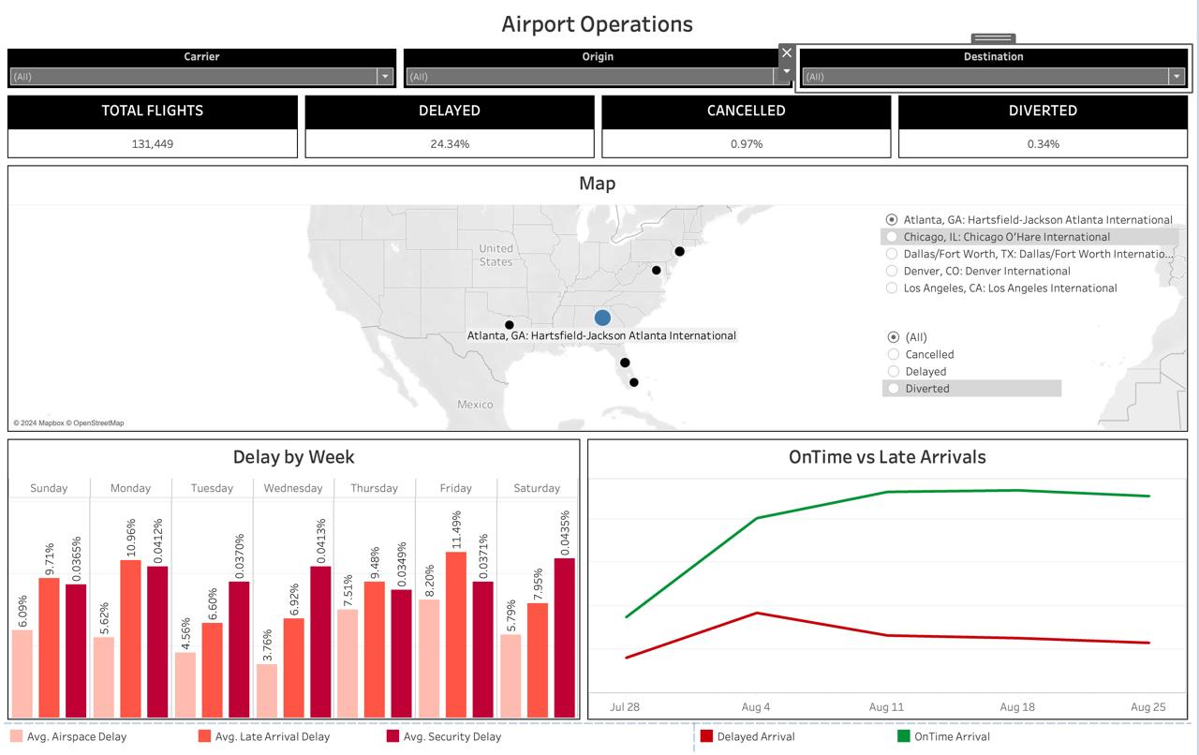
AIRPORT PERFORMANCE DASHBOARD
OUR PROJECTS
Findings per Airport:
Delay by Week
OnTime vs Late Arrivals
Total Flights
Delayed/Cancelled/Diverted Percentage

Slide 8
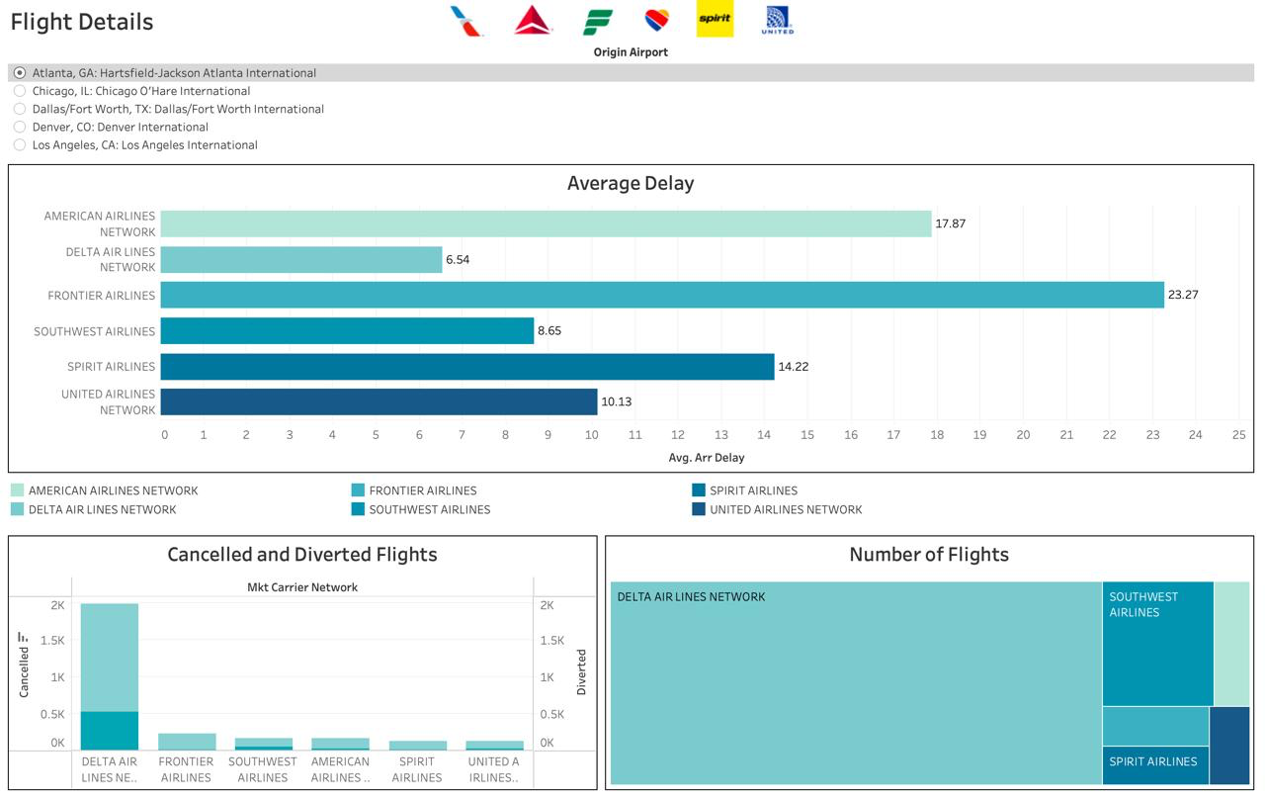
OPERATIONAL METRICS DASHBOARD
OUR PROJECTS
Findings per Airline:
Average Delay
Number of Flights
Cancelled and Diverted Flights

Slide 9
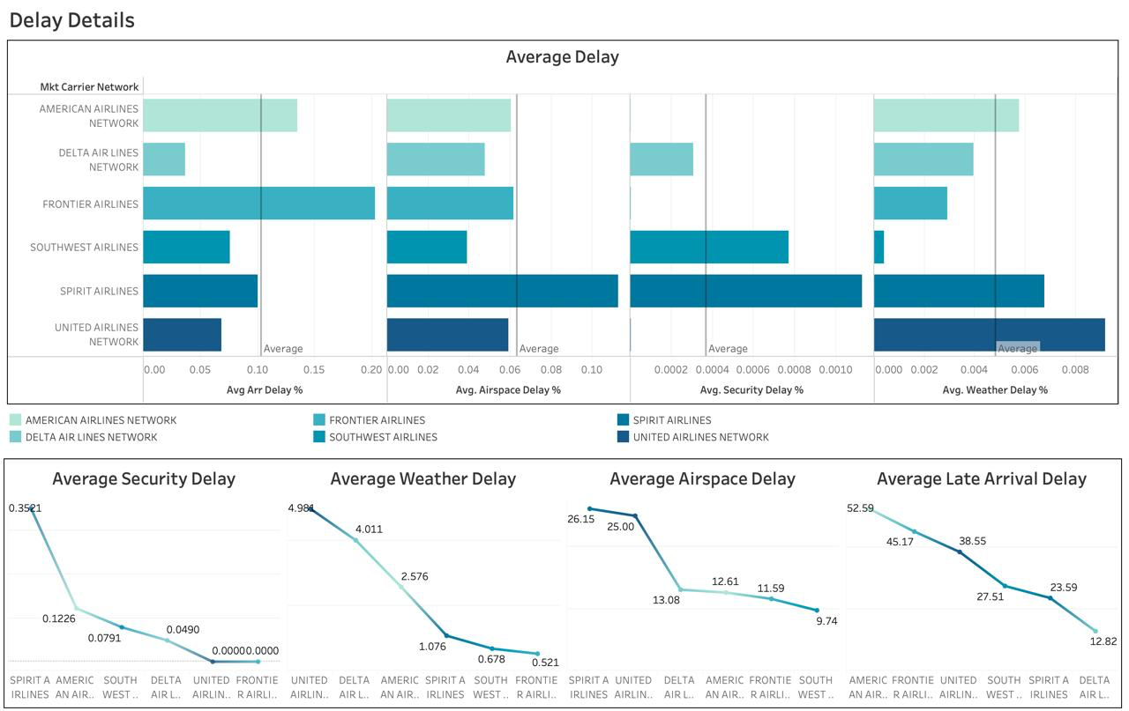
DELAY ANALYSIS DASHBOARD
OUR PROJECTS
Findings per Airline:
Market Carrier Network Analysis
Average Security/Weather/ Airspace/Late Arrival Delay

Slide 10
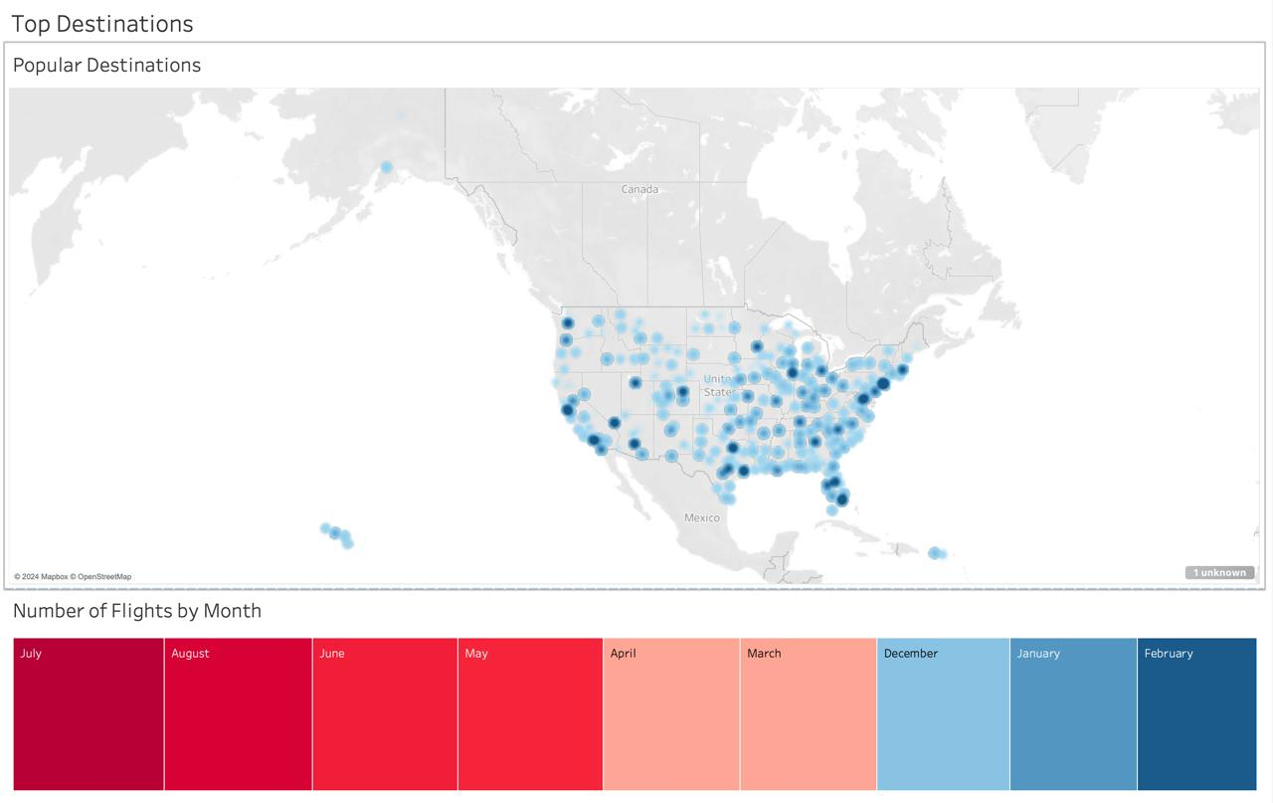
DESTINATIONS AND FLIGHT VOLUME DASHBOARD
OUR PROJECTS
Findings for Destinations:
Top Destinations per Month
Density of Flights per Month

Slide 11
OUR RECOMMENDATION
Collaborate with air traffic control to optimize flight paths and schedules to reduce airspace delays.
Allocate more ground staff and streamline baggage handling and refueling processes to improve turnaround efficiency.
Encourage midweek flight schedules to alleviate peak-day congestion to handle peak times.
Collaborate with underperforming airlines (e.g., United, Spirit) to address recurring delays to improve airline coordination.
Offer targeted promotions in retail and dining areas during peak delays to leverage dwell time.
Promote discounted off-peak flights and terminal advertising during slower months to maximize non-peak usage.

Slide 12
AIRPORT-WISE RECOMMENDATION
Atlanta (ATL): Late Arrival Delays
Optimize turnaround operations (baggage, fueling, boarding).
Introduce buffer times in flight schedules.
Use predictive analytics to manage late arrivals proactively.
Dallas (DFW): Airspace Delays
Collaborate with FAA to enhance air traffic flow management.
Redistribute flight schedules to reduce peak-hour congestion.
Implement advanced air traffic systems (e.g., Performance-Based Navigation).

Slide 13
AIRPORT-WISE RECOMMENDATION
Los Angeles (LAX): Average Delays (Frontier Airlines)
Work with Frontier Airlines to address operational inefficiencies.
Improve gate management for faster taxi and boarding.
Streamline security and boarding processes for peak-hour efficiency.
Chicago (ORD): High Flight Cancellations
Develop weather-focused contingency plans for quicker recovery.
Schedule maintenance during off-peak periods to avoid disruptions.
Enhance passenger communication and proactive rebooking options.

Slide 14

EMPOWERING SMARTER TRAVEL WITH DATA-DRIVEN INSIGHTS!
Thank You

